Slide 1
​InternHub: Bridging Talent & Opportunity
Your Gateway to Professional Growth and Tech Excellence

Slide 2
​Who We Are ?
Empowering the Next Generation (Connecting ambitious learners with real-world tech opportunities).
Bridging the Gap (Transforming theoretical knowledge into practical, industry-ready skills).
Community-Driven (Built for students, self-learners, and future tech leaders).

Slide 3

The Problem & Our Solution
⚠️ The Problem
🚀 Our Solution
📉
Students struggle to find practical, real-world internships, and traditional education lacks hands-on industry connection.
🎯
InternHub bridges this gap by directly connecting ambitious learners with verified companies through a seamless platform.

Slide 4
Our Execution Roadmap & Phases
​A structured approach to transforming ideas into functional, user-ready digital solutions.
Developing secure APIs using Node.js & Express, and managing data with MongoDB for authentication and applications.
Wireframing user journeys, designing clean interfaces, and ensuring a seamless user experience.
Building responsive interfaces using React, JavaScript, and Bootstrap for an interactive student experience.
Phase 2: Frontend (React)
Phase 1: UI/UX Design
Phase 3: Backend & Database

Slide 5
Tech Stack & Tools
Frontend UI💻
Backend Server⚙️
React.js & JavaScript for interactive user interfaces
Node.js & Express RESTful APIs for secure operations
Styling & Design🎨
Database📊
Bootstrap & responsive layout for seamless student experience
MongoDB for flexible and reliable data management

Slide 6
System Architecture & Request Flow
​💻
1.Frontend (React):
User interacts with the responsive UI, triggering actions like login, searching, or submitting internship applications via HTTP requests.
🛠️
2.Backend API (Node.js):
Express server processes incoming requests, handles authentication tokens, applies business logic, and executes validation rules.
🗃️
3.Database (MongoDB):
Mongoose models securely query, store, and update data for users, companies, listings, and applications in real-time collections.

Slide 7
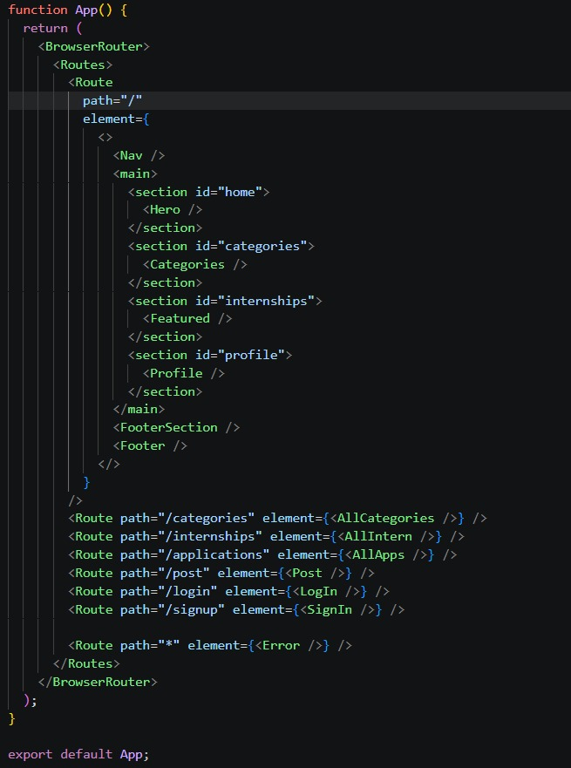
Frontend Routes
We used React Router to navigate between the pages of the website.
The Home Page / contains the main components such as Hero, Categories, Internships, and Profile.
Each page has its own route, such as :
. "/internships“
. "/applications“
. "/post“
. "/login“
. "/signup“
We also used an Error Route to display the Error Page when the user enters an invalid URL.

Slide 8
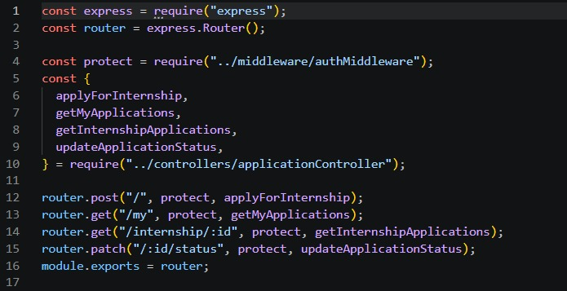
Backend Routes
We used Express Router to organize the API routes.
. POST / → Apply for an internship
. GET /my → Display the user's applications
. GET /internship/:id → Display applications for a specific internship
. PATCH /:id/status → Update the application status.
We also used Protect Middleware to secure the routes and make sure that the user is logged in.

Slide 9
Database Schema & Collections
👤
1. Users Collection
​Fields: name, email, password, role (Student / Company)
Purpose: Manages user registration, authentication, and role-based permissions securely.
💼
2. Internships Collection
​Fields: title, companyId, description, techStack, location, duration.
​Purpose: Stores all internship listings and opportunities posted by companies.
​📋
3.Applications Collection
​
Fields: studentId, internshipId, status (Pending / Accepted / Rejected), appliedAt
​Purpose: Tracks student applications, real-time status updates, and history.

Slide 10
​Core Features & Functionality
​
1
Role-Based Authentication
Secure sign-up and login tailored for both Students and Companies.
Smart Search & Filtering
Easily discover internships by category, location, or required tech stack.
2
Application Management
Students can apply seamlessly and track their application status in real-time.
3
Interactive Dashboards
Personalized control panels to manage profiles, track activity, and view posts.
4

Slide 11
Future Scope & Roadmap
​🤖
AI-Powered Matching
Integrating smart algorithms to match students with internships based on their skills.
​📱
Mobile Application
Launching dedicated Android and iOS apps for a smoother mobile experience.
​📊
Advanced Analytics
Providing deeper performance tracking and analytics dashboards for companies.

Slide 12
Our Development Team
Front-End & UI/UX Team
Back-End & Database Team
Fatema Mohey Eldin Mostafa
Mohamed Ehab Abdrabo
Fatma Salama Elkholy
Farah Amin Elsadik
Sohaila Bahgat Ahmed
Badr Ahmed Sayed
Antonyos Moures Ibrahim

Slide 13
Thank You!
Questions & Answers 💡

